Slide 1
Linux System Programming Essentials
Development Tools
Compilers
Debuggers
Build Tools
System Calls & APIs
Application Developments
O.S. Internals

Slide 2
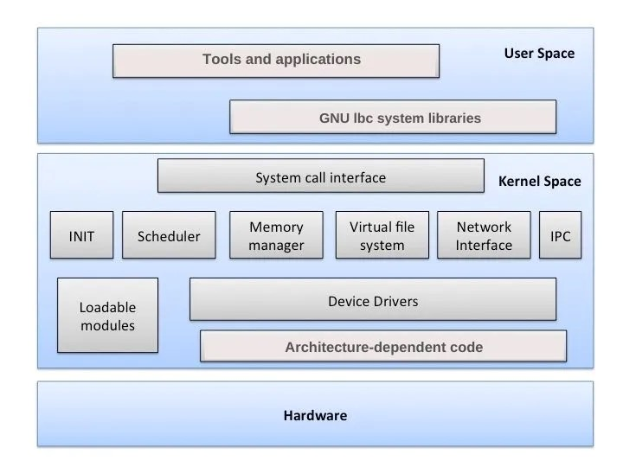
Operating System
Shell
Kernel
BSP
**Board Specific Package

Slide 3
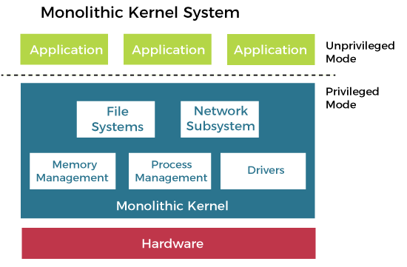
Types of Kernel Architecture
Monolithic Kernel (Linux)
Integrated Kernel Approach
All the parts of a kernel like the Scheduler, File System, Memory Management, Networking Stacks, Device Drivers, etc., are maintained in one unit within the kernel in Monolithic Kernel
Advantages
Faster processing
Disadvantages
Crash Insecure
Porting Inflexibility
Kernel Size explosion
Examples MS-DOS, Unix, Linux

Slide 4
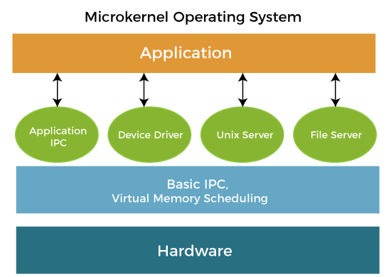
Micro Kernel (QNX)
Only the very important parts like IPC(Inter process Communication), basic scheduler, basic memory handling, basic I/O primitives etc., are put into the kernel.
Communication happen via message passing.
Others are maintained as server processes in User Space
Advantages
Crash Resistant, Portable, Smaller Size
Disadvantages
Slower Processing due to additional Message Passing
Example : Windows NT, QNX, MAC OS

Slide 5
History of Linux
In 80’s, Microsoft’s DOS was the dominated OS for PC
Apple MAC was better, but expensive
UNIX was much better, but much, much more expensive. Only for minicomputer for commercial applications
People was looking for a UNIX based system, which is cheaper and can run on PC
Both DOS, MAC and UNIX were proprietary, i.e., the source code of their kernel is protected
No modification is possible without paying high license fees
Prof. Andrew Tanenbaum's Personal Computer operating system Minix brought the study of operating systems from a theoretical basis to a practical one.
And finally, Linus Torvald's endless enthusiasm for perfection gave birth to Linux

Slide 6
Advantages of Linux
Linux is free and open source
Linux is Portable to any hardware platform
Linux was made to keep on running [using as SERVERS]
Linux is secure and versatile
Linux is scalable
Linux OS and few Linux application have very short debug time [GDB,KGDB,KDB]
Disadvantages of Linux
There are far too many distribution of Linux
Linux is not very user friendly & Confusing for beginners

Slide 7
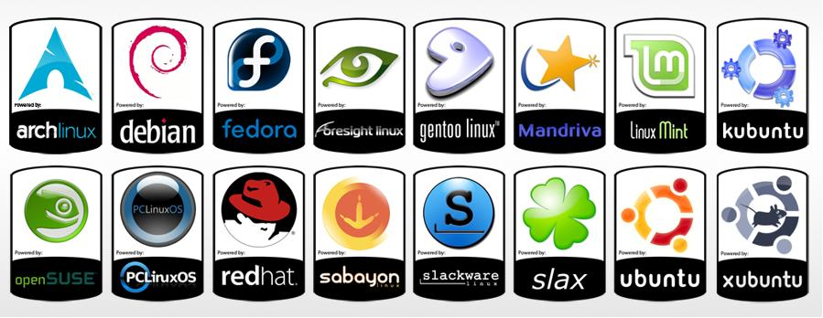
Flavors of Linux | Distro’s of Linux kernel
RPM Based
Suse (Novell )
RedHat ,Fedora (Red Hat incorporated)
Cent OS (community based)
Debian Based
Debian itself (community based)
Ubuntu(conical Ltd)(Case Study)
Xandros (Xandros.com)
Mepis (Mepis.com)
Source Based
Slackware (community based)

Slide 8
Flavors of Linux (Similarities)
Kernel
Similar libraries (development libraries)
Basic utilities(e.g. text editors,shells,network)
Daemons (e.g. printer,http,ftp,ssh e.t.c)
Drivers (e.g. ntfs,hardware e.t.c)
Modules (e.g network cards modules)
Flavors of Linux (Differences)
Installation procedures (System installers)
Desktop Environments (KDE,Gnome e.t.c)
Bundled Applications (Multimedia applications e.t.c)
Bundled Libraries
System Configurations(e.g. Web server,Media server,workstation)
Hardware support out-of-the-box
Package Managers (Adept,Synaptic,Yum,Yast .e.t.c)

Slide 9
Why Linux?
Configurability
The source code, to be modified as fit for our requirement.
Convenience
While Linux takes some effort to set up, once it is set up, it is surprisingly low-maintenance. Package management
Stability
Linux is based on the UNIX kernel. It provides preemptive multitasking and protected memory.
Community
Linux is part of the greater open-source community. This consists of thousands of developers and many more users world-wide who support open software.
The user and developer base is also a support base.
Freedom
Linux is free.

Slide 10
Multi
User
Multi Threading
Multi Tasking
Linux Features
Multi Platform
Multi Processing

Slide 11
Linux Kernel Architecture
User Programs
User Programs
Trap
User level
Libraries
Kernel level
System Call Interface
File System Management
IPC
Buffer Cache
Process
Mgt.
Scheduling
Device Drivers
Memory Mgt.
Hardware Control (Interrupts handling, etc)
Hardware

Slide 12
Kernel Space | User Space
Kernels and OS core execute here. | Normal program and applications softwares run here.
Its the core space of OS. | It's a form of sand-boxing that restricts user processes to access OS kernel.
It has full access to all memory and machine hardware. | It has limited access to memory and access kernel through system calls only.
It contains the page table for process, kernel data structure, threads, and kernel code etc. It also contains code, data, stacks and heap sections. | It contains the program code, data, stacks, and heap of the process.

Slide 13
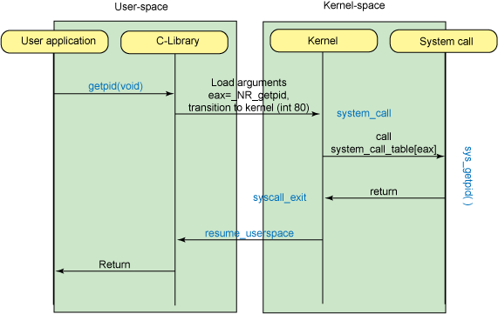
System Calls
The kernel provides a set of interfaces for applications running in user mode to interact with the system. These interfaces, also known as system calls
System calls give applications access to hardware and other kernel resources.
System calls ensure security and stability.

Slide 14
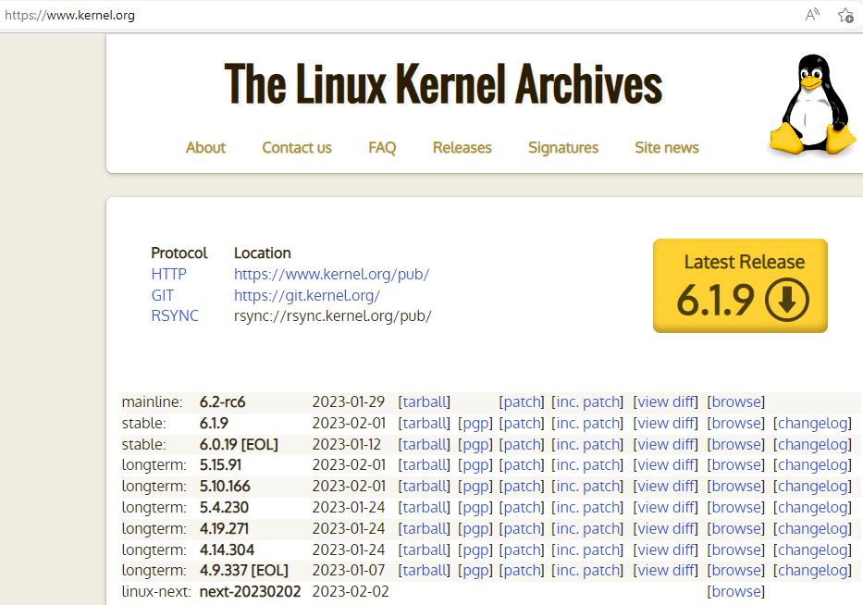
Linux Kernel Versions
Version number: kernel-x.y.z
x = major version number
y = minor version number
z = patch level
There are 2 threads of activity with regard to the kernel.
Stable
Development
To tell them apart, check the minor version number.
stable = even minor version number
development = odd minor version number
Examples:
Stable : 2.2.x
Development : 2.3.x

Slide 15
Thank You…

